Slide 1
Recognition of handwriting digits by Deep Neural Network(DNN)
CSC 611
Advisor: Dr. Weihua Zhou
Presenter: Haipeng Tang

Slide 2
Outline
Introduction of MNIST
Goals
Build, train, and evaluate a DNN model

Slide 3
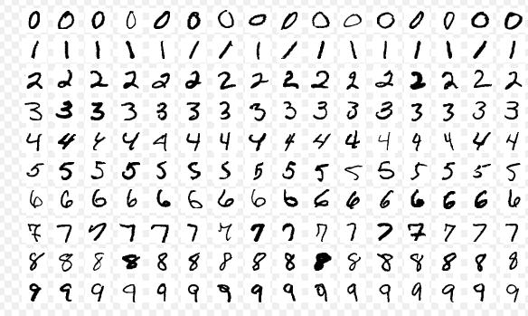
The MNIST database(Modified National Institute of Standards and Technology database) is a large database of handwritten digits that is commonly used for training various image processing systems.
URL: http://yann.lecun.com/exdb/mnist/
Notes:
For DNN beginners, we can use it to build our own dnn models.
Good dataset to learn Neural networks.

Slide 4
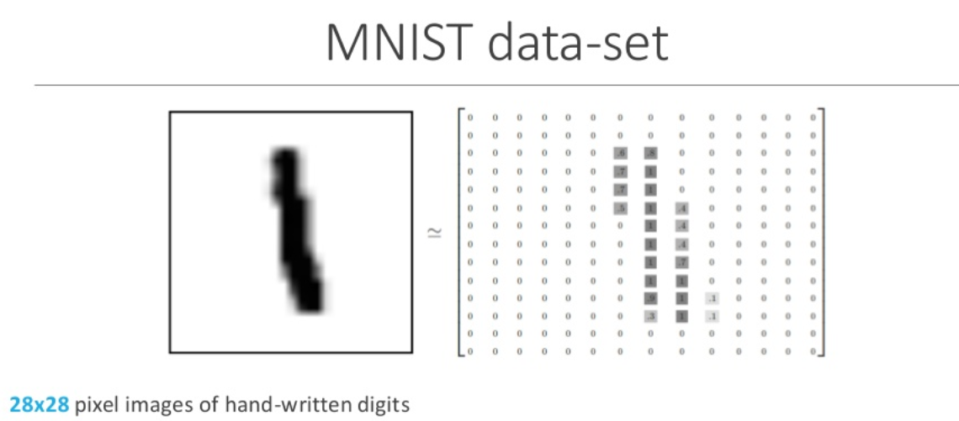
Every image can be thought of as an array of numbers(gray levels).
So a 28×28 image can become an array of 1×784.(Q: Dementia data,41 features?)
Training set: 60000; specifically, 6000 “0”, 6000 “1”, 6000 “2”……
Test set: 10000; specifically, 1000 “0”, 1000 “1”, 1000 “2”……

Slide 5
Goals
Train a DNN model which can recognize handwriting digits
Test the accuracy of the trained model
training set: 60000
test set: 10000
Investigate which and how the parameters can affect the accuracy of the model
Notes:
How to test model accuracy.
1 is 1, 3 is 11

Slide 6
Build DNN model by Keras
Introduction of Keras
By Zhuo He

Slide 7
Build DNN model by Keras
(1) Set up the layers and neurons
(2) Compile the model
(3) Train the model

Slide 8
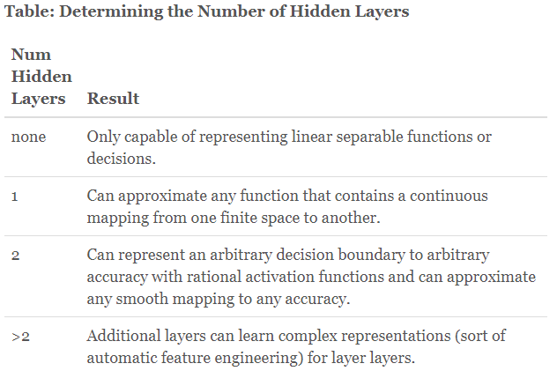
(1) Set up the layers and neurons
The basic building block of a neural network is the layers and neurons.
Number of layers: One researcher proposed
that, generally, 2 hidden layers will enable
the network to model any arbitrary function.
URL(https://www.heatonresearch.com/2017/06/01/hidden-layers.html)
Notes:
If simple image or data, 2-3 layers might be enough.

Slide 9
(1) Set up the layers and neurons
Number of neurons:
Some rules:
The number of neurons is the mean of the neurons in the input and output layers.
The number of hidden neurons should be between the size of the input layer and the size
of the output layer.
The number of hidden neurons should be 2/3 the size of the input layer, plus the size of the
output layer.
4. The number of hidden neurons should be less than twice the size of the input layer.
These rules can only provide a starting point to consider. We have to adjust them according to trials and errors.

Slide 10

(1) Set up the layers and neurons
Keras code:
Parameters: Dense(neurons), hidden layers, and activation function.
(ReLU, sigmoid, softmax, Tanh, Linear, step)
Notes:
Dropout will help avoid overfitting.
Which activation function is good? Decide by trials.

Slide 11
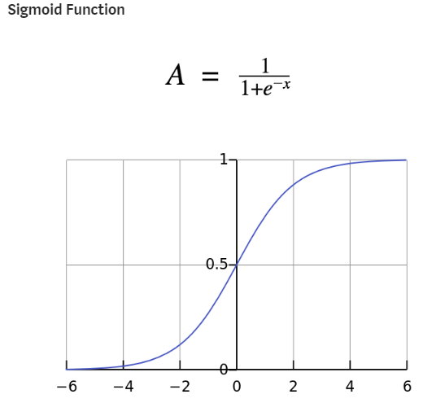

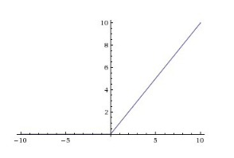
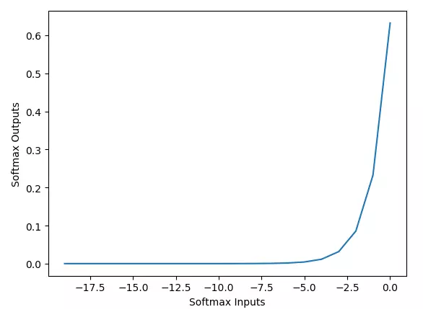
Activation functions
Notes:
No selection rules

Slide 12


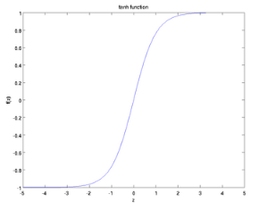

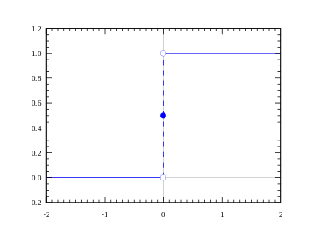
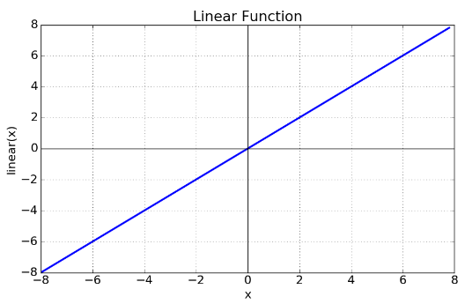
Activation functions

Slide 13


(2) Compile the model
Before the model is ready for training, it needs a few more settings. These are added during the model's compile step:
Loss function —This measures how accurate the model is during training. We want to minimize this function to “steer” the model in the right direction.
Commonly used: categorical_crossentropy, mean_squared_error

Slide 14

(2) Compile the model
Optimizer —This is how the model is updated based on the data it sees and its loss function.
Commonly used: AdamOptimizer, RMSPropOptimizer, GradientDescentOptimizer
Metrics —Used to monitor the training and testing steps. The following example uses accuracy, the fraction of the images that are correctly classified.

Slide 15
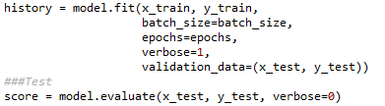
(3)Train and test the model
Training the neural network model requires the following steps:
Feed the training data to the model,
The model learns to associate images and labels.
We ask the model to make predictions for a test set.
Parameters: batch_size(32, 64, 128), epochs(iteration),
Notes:
but there is a threshold of overfitting, resulting in high training accuracy and low test accuracy

Slide 16
Training set
Test set
Validation set
Validation set
Training set
Test set

Slide 17
Code introduction:

Slide 18
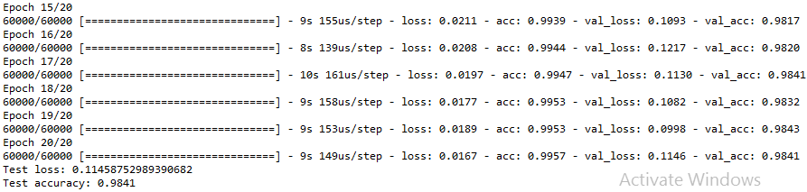
Results

Slide 19
Parameters:
Iteration: batch_size, num_classes, epochs.
Model: layers, neurons, dropout(0.1, 0.2, 0.3),
activation function: relu, sigmoid, softmax, LeakyReLU, tanh, linear
Loss functions: sparse_categorical_crossentropy, mean_squared_error, mean_absolute_error, L1, L2
Optimizer: AdamOptimizer, RMSPropOptimizer,
GradientDescentOptimizer,

Slide 20
Some open questions?
How many parameters can be adjusted.
What will be influenced by adjusting those parameters.
How to get and use validation set to validate the accuracy in training.

Slide 21



